Slide 1

Student Lifestyle dataset
Subtitle:
Prepared By : Sanjana Musale
Date 08 November 2025
Tool Used : Microsoft Power BI

Slide 2
Objective
to analyze how student’s , daily habits – like study hours, sleep time, internet use , and physical activity and stress level and student lifestyle pattern

Slide 3
Key Insights Summary
Balanced Lifestyle Better academic success.
Students who study 5 – 7 hours, sleep 7 – 8 hours, and stay active perform best.
Stress management and time discipline are key factors in high GPA performance.

Slide 4
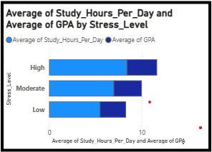
Average Study Hours and GPA by stress Level
The Bar chart shows that students with low stress levels have the highest GPA followed by Moderate stress students. High-stress student ted to have lower academic performance.

Slide 5
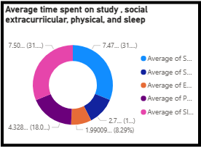
Average Time Spent on Different Activities (per day)
This donut chart shows how a students daily 24 hours are divided among activities like study, socializing, extracurricular, physical activity, and sleep

Slide 6
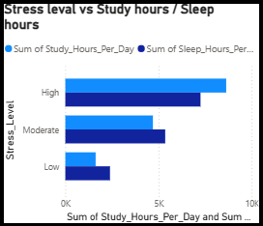
Average Study Hours and Sleep Hours by Stress Level
This chart compares how many hours students study daily at each stress level (high, Moderate, low),
It helps you understand whether stress affects how much time students spend studying

Slide 7
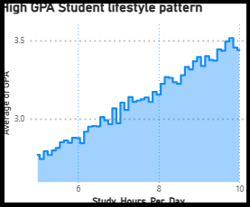
Average GPA by study Hours per day
this line chart shows that students who study 5 – 7 hours per day tend to achieve a higher (5.2 – 9.0).
study time and academic performance.
this pattern indicated that regular study habits improve results.

Slide 8
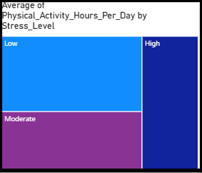
Average physical Activity hours per day by Stress Level
The Treemap shows that students with Low stress levels spend more time on physical Activity (around 2.6 – 3 hours / day).
High stress levels spend less time under( 1 hour/ day),
This suggests that regular physical activity is linked to lower stress among students.

Slide 9
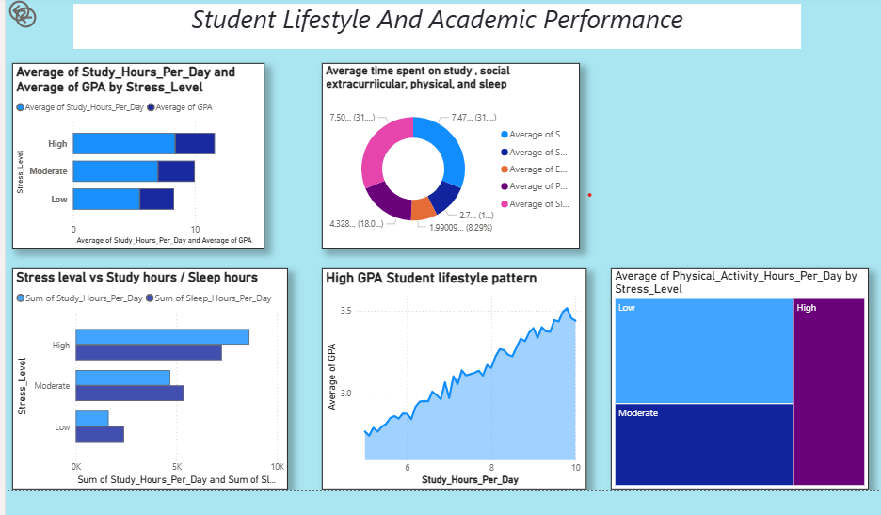

Slide 10
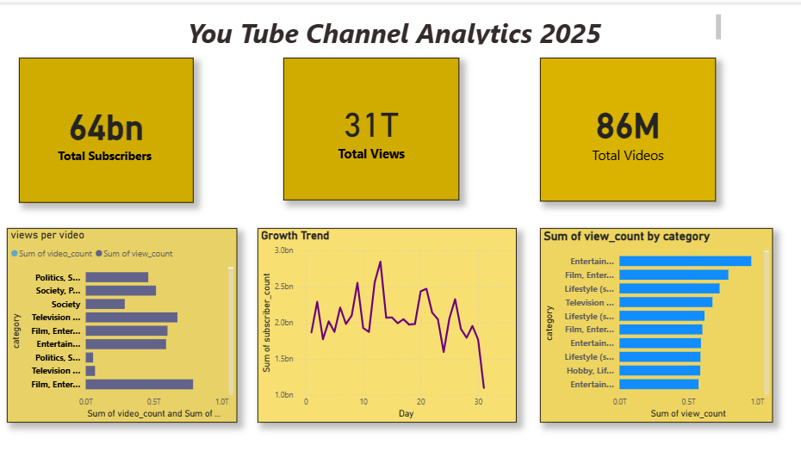
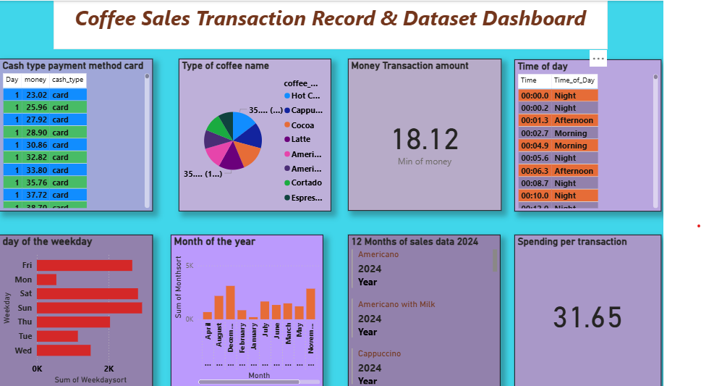
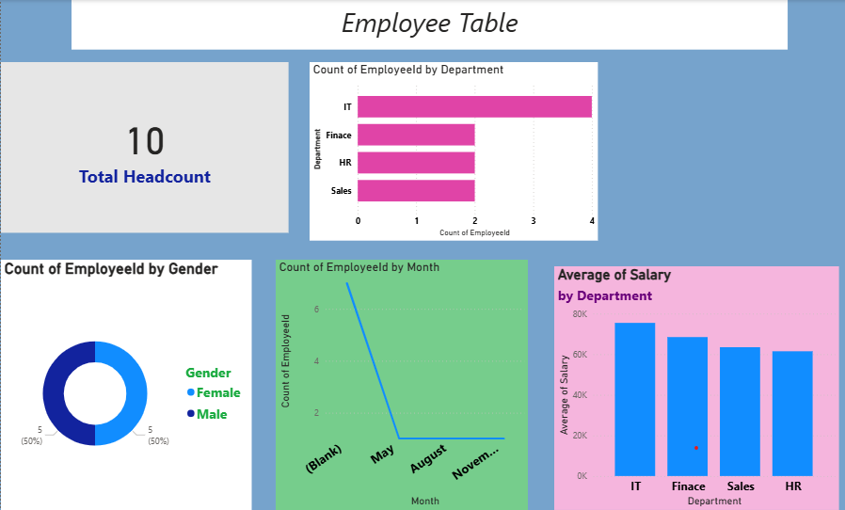

Other Actives

Slide 11


